Slide 1
Principles of Connecetd Devices and Protocols in IOT
Module 3

Slide 2
Sensors are fundamental building blocks of IoT networks
Sensors are the foundational elements found in smart objects—the “things” in the Internet of Things
Smart objects are any physical objects that contain embedded technology to sense and/or interact with their environment in a meaningful way by being interconnected and enabling communication among themselves or an external agent.
https://www.finoit.com/blog/top-15-sensor-types-used-iot/

Slide 3
SENSORS, ACTUATORS, AND SMART OBJECTS
A sensor: It senses
More specifically, a sensor measures some physical quantity and converts that measurement reading into a digital representation.
That digital representation is typically passed to another device for transformation into useful data that can be consumed by intelligent devices or humans
Sensors are not limited to human-like sensory data.
They are able to provide an extremely wide spectrum of rich and diverse measurement data with far greater precision than human senses – superhuman sensory capabilities

Slide 4
SENSORS, ACTUATORS, AND SMART OBJECTS
A sensor: It senses
More specifically, a sensor measures some physical quantity and converts that measurement reading into a digital representation.
That digital representation is typically passed to another device for transformation into useful data that can be consumed by intelligent devices or humans
Sensors are not limited to human-like sensory data.
---They can measure anything worth measuring
They are able to provide an extremely wide spectrum of rich and diverse measurement data with far greater precision than human senses; sensors provide superhuman sensory capabilities

Slide 5
Cntd….
This additional dimension of data makes the physical world an incredibly valuable source of information.
Sensors can be readily embedded in any physical objects that are easily connected to the Internet by wired or wireless networks.
Because these connected host physical objects with multidimensional sensing capabilities communicate with each other and external systems, they can interpret their environment and make intelligent decisions.
Connecting sensing devices in this way has ushered in the world of IoT and a whole new paradigm of business intelligence
There are myriad different sensors available to measure virtually everything in the physical world. There are a number of ways to group and cluster sensors into different categories, including the following:

Slide 6
Categories
Active or passive:
Sensors that produce an energy output and typically require an external power supply (active) .
e,g Strain guage, ultrasonic sensor
Sensors that simply receive energy and typically require no external power supply (passive).
e.g Thermocouple which generates a voltage value corresponding to the heat applied.
A light sensor which detects if a light is shining on it
An infra-red sensor which detects the temperature of an object

Slide 7
Active sensor:
An active sensor is one which transmits a signal into the environment and then measures the response that comes back. e.g ultrasonic system
A pulse of ultrasound is emitted
If an object is in the way, the pulse is reflected back
The sensor detects it
The time taken between emission and detection gives an indication of the distance of the object.
Passive Sensor
A passive sensor is one which just ‘listens’ to what is happening.
Examples include:
A light sensor which detects if a light is shining on it
An infra-red sensor which detects the temperature of an object

Slide 8
Categories
Invasive(wearable) or non-invasive(implantable):
Sensors can be categorized based on whether a sensor is part of the environment it is measuring (invasive) or
External to it (non-invasive).
Examples :
Invasive: ECG, Glucose sensor,Temperature, BP,pulse Oxymeter etc..
Non Invasive: Pacemaker, Retina implant

Slide 9
Analog Vs Digital Sensors
Analog sensors produce analog output i.e a continuous output signal w.r.t. the quantity being measured.
Generally analog voltage in the range of 0 to 5 volts or current is produced as output. (temp,stress,pressure,displacement are ex of continuous signals.)
Examples of Analog sensors are accelerometers, speed sensors, pressure sensors,light sensors,temperature sensors
Digital sensors work with discrete or digital data.
Example is digital accelerometer.

Slide 10
Contact or no-contact:
Sensors can be categorized based on whether they require physical contact with what they are measuring (contact) or not (no-contact).
Examples include Oral thermometer(Contact) and Infrared thermometer(No-contact)

Slide 11
Absolute or relative:
Sensors can be categorized based on whether they measure on an absolute scale (absolute) or based on a difference with a fixed or variable reference value (relative).
Ex. An absolute pressure sensor measures the pressure in relation to a reference pressure which is the vacuum.
A relative pressure sensor refers to the ambient atmospheric pressure and therefore measures the difference between the process pressure and the atmospheric pressure.

Slide 12
Area of application:
Sensors can be categorized based on the specific industry or vertical where they are being used.
e.g physical sensors, chemical, biological sensors etc..
What sensors measure:
Sensors can be categorized based on their applications
or what physical variables they measure.
– This is the most useful classification scheme for the pragmatic application of sensors in an IoT network.

Slide 13
Note that this is by no means an exhaustive list, and there are many other classification and taxonomic schemes for sensors, including those based on material, cost, design, and other factors.
The most useful classification scheme for the pragmatic application of sensors in an IoT network is to simply classify based on what physical phenomenon a sensor is measuring

Slide 14
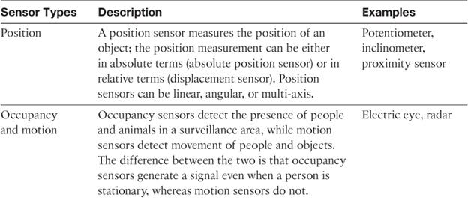
Categorization based on what physical phenomenon a sensor is measuring

Slide 15
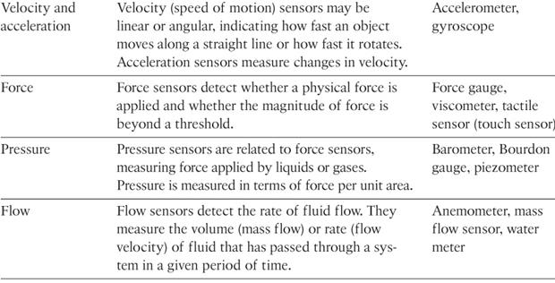
11

Slide 16
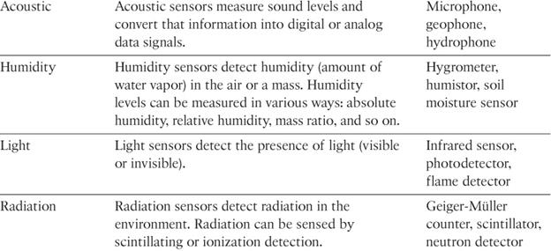

Slide 17
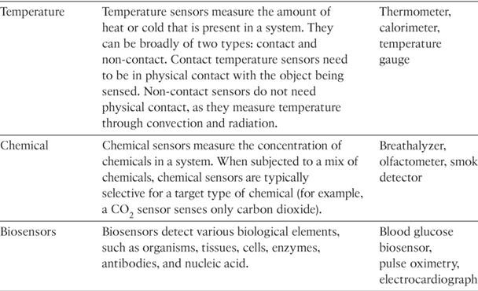
https://www.finoit.com/blog/top-15-sensor-types-used-iot/

Slide 18
Precision agriculture (smart farming)
A fascinating use case to highlight the power of sensors and IoT is in the area of precision agriculture (sometimes referred to as smart farming), which uses a variety of technical advances to improve the efficiency, sustainability, and profitability of traditional farming practices.
This includes the use of GPS and satellite aerial imagery for determining field viability; robots for high-precision planting, harvesting, irrigation, and so on; and real-time analytics and artificial intelligence to predict optimal crop yield, weather impacts, and soil quality.
Among the most significant impacts of precision agriculture are those dealing with sensor measurement of a variety of soil characteristics. These include real- time measurement of soil quality, pH levels, salinity, toxicity levels, moisture levels for irrigation planning, nutrient levels for fertilization planning, and so on.
All this detailed sensor data can be analyzed to provide highly valuable and
actionable insight to boost productivity and crop yield.

Slide 19
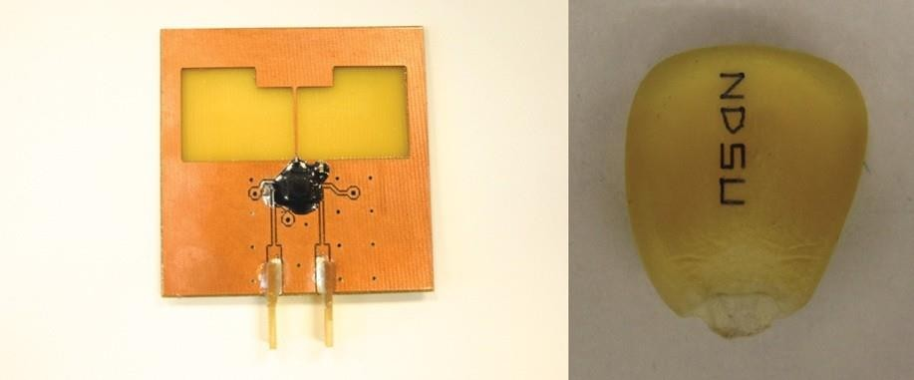
IoT Use Case: Area of precision agriculture (smart farming)
biodegradable, passive microsensors to measure soil and crop conditions.
These sensors, developed at North Dakota State University (NDSU), can be planted directly in the soil and left in the ground to biodegrade without any harm to soil quality.

Slide 20
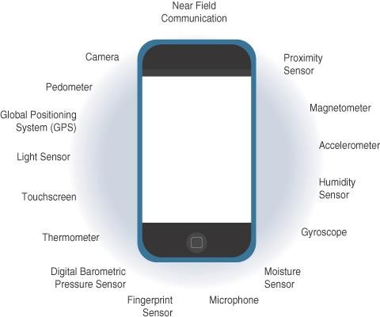
Sensors in a Smart Phone

Slide 21
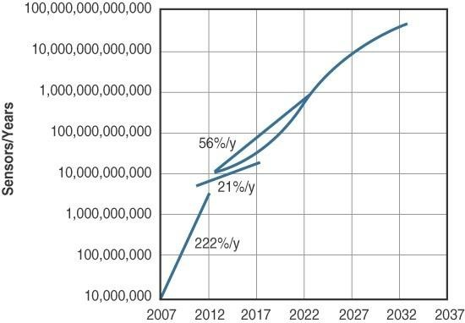
Figure 3-3 Growth and Predictions in the Number of Sensors

Slide 22
Actuators
Actuators are natural complements to sensors
Sensors are designed to sense and measure practically any measurable variable in the physical world.
They convert their measurements (typically analog) into electric signals or digital representations that can be consumed by an intelligent agent (a device or a human).
Actuators, on the others hand, receive some type of control signal (commonly an electric signal or digital command) that triggers a physical effect, usually some type of motion, force, and so on.
Sensors provide the information, actuators provide the action

Slide 23
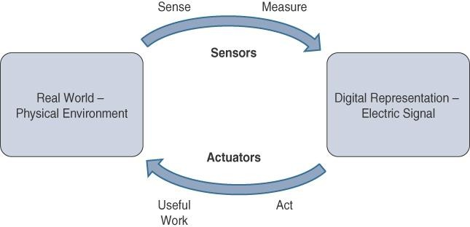

Figure demonstrates the symmetry and complementary nature of these two types of devices

Slide 24
Humans use their five senses to sense and measure their environment.
The sensory organs convert this sensory information into electrical impulses that the nervous system sends to the brain for processing.
Likewise, IoT sensors are devices that sense and measure the physical world and (typically) signal their measurements as electric signals sent to some type of microprocessor or microcontroller for additional processing.
The human brain signals motor function and movement, and the nervous system carries that information to the appropriate part of the muscular system.
Correspondingly, a processor can send an electric signal to an actuator that translates the signal into some type of movement (linear, rotational, and so on) or useful work that changes or has a measurable impact on the physical world.
This interaction between sensors, actuators, and processors and the similar functionality in biological systems is the basis for various technical fields, including robotics and biometrics.

Slide 25
IoT sensors are devices that sense and measure the physical world and (typically) signal their measurements as electric signals sent to some type of microprocessor or microcontroller for additional processing.
A processor sends an electric signal to an actuator that translates the signal into some type of movement (linear, rotational, and so on) or useful work that changes or has a measurable impact on the physical world.

Slide 26
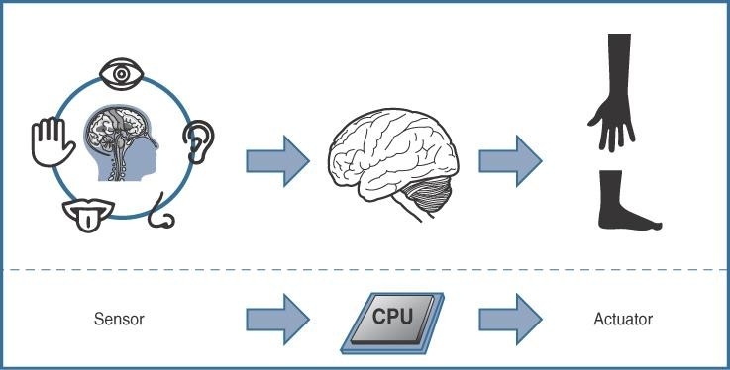

Slide 27
Like sensors, Actuators also vary greatly in function, size, design, and so on.
Some common ways that they can be classified include the
following:
Type of motion: Actuators can be classified based on the type of motion they produce (for example, linear, rotary, one/two/three- axes).
Power: Actuators can be classified based on their power output (for example, high power, low power, micro power)
Binary or continuous: Actuators can be classified based on the number of stable-state outputs.
Area of application: Actuators can be classified based on the specific industry or vertical where they are used.
Type of energy: Actuators can be classified based on their energy type.

Slide 28
Types of Actuators :
1. Hydraulic Actuators –
A hydraulic actuator uses hydraulic power to perform a mechanical operation. They are actuated by a cylinder or fluid motor. The mechanical motion is converted to rotary, linear, or oscillatory motion, according to the need of the IoT device.
Ex- construction equipment uses hydraulic actuators because hydraulic actuators can generate a large amount of force.
Advantages :
Hydraulic actuators can produce a large magnitude of force and high speed.
Used in welding, clamping, etc.
Used for lowering or raising the vehicles in car transport carriers.
Disadvantages :
Hydraulic fluid leakages can cause efficiency loss and issues of cleaning.
It is expensive.
It requires noise reduction equipment, heat exchangers, and high maintenance systems.

Slide 29
Types of Actuators :
2. Pneumatic Actuators –
A pneumatic actuator uses energy formed by vacuum or compressed air at high pressure to convert into either linear or rotary motion.
Example- Used in robotics. Robots use sensors that work like human fingers by using compressed air.
Advantages :
They are a low-cost option and are used at extreme temperatures where using air is a safer option than chemicals.
They need low maintenance, are durable, and have a long operational life.
It is very quick in starting and stopping the motion.
Disadvantages :
Loss of pressure can make it less efficient.
The air compressor should be running continuously.
Air can be polluted, and it needs maintenance.

Slide 30
Types of Actuators :
3. Electrical Actuators –
An electric actuator uses electrical energy, is usually actuated by a motor that converts electrical energy into mechanical torque.
An example of an electric actuator is a solenoid based electric bell.
Advantages :
It has many applications in various industries as it can automate industrial valves.
It produces less noise and is safe to use since there are no fluid leakages.
It can be re-programmed and it provides the highest control precision positioning.
Disadvantages :
It is expensive.
It depends a lot on environmental conditions.

Slide 31
Types of Actuators :
4. Thermal/Magnetic Actuators – These are actuated by thermal or mechanical energy. Shape Memory Alloys (SMAs) or Magnetic Shape‐Memory Alloys (MSMAs) are used by these actuators.
An example of a thermal/magnetic actuator can be a piezo motor using SMA.
5. Mechanical Actuators – A mechanical actuator executes the movement by converting rotary motion into linear motion. It involves pulleys, chains, gears, rails, and other devices to operate. Example – A crankshaft.

Slide 32
Commonly used actuators in IoT System
Linear Actuators: used to enable motion of objects in a straight line.
Motors: used for precise rotational movements of device components or whole objects.
Relays: Used for operating power switches in lamps, heaters or even small vehicles.
Solenoids: used in home appliances as a part of locking or triggering mechanisms. They also act as controllers in IoT-based gas and water leak monitoring systems.

Slide 33
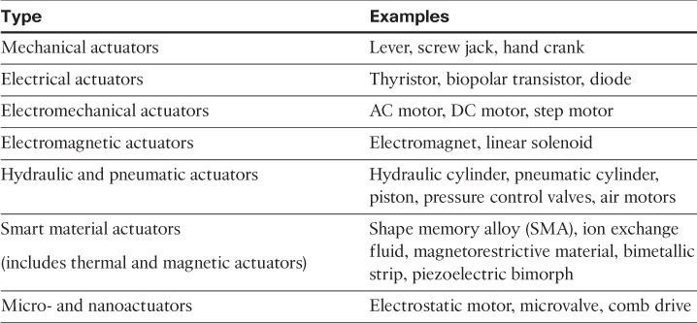
Classification based on energy type

Slide 34
The combination of tiny size, low cost, and the ability to mass produce makes MEMS an attractive option for a huge number of IoT applications.
MEMS devices have already been widely used in a variety of different applications and can be found in very familiar everyday devices.
For example, inkjet printers use micropump MEMS.
Smart phones also use MEMS technologies for things like accelerometers and gyroscopes.
In fact, automobiles were among the first to commercially introduce MEMS into the mass market, with airbag accelerometers.

Slide 35
Micro-Electro-Mechanical Systems (MEMS)
Interesting advances in sensor and actuator technologies is in how they are packaged and deployed.
Micro-electro-mechanical systems (MEMS), sometimes simply referred to as micro-machines, can integrate and combine electric and mechanical elements, such as sensors and actuators, on a very small (millimeter or less) scale.
One of the keys to this technology is a microfabrication technique that is similar to what is used for microelectronic integrated circuits.
This approach allows mass production at very low costs

Slide 36
Smart Objects
Smart objects are, quite simply, the building blocks of IoT.
They are what transform everyday objects into a network of intelligent objects that are able to learn from and interact with their environment in a meaningful way.
The real power of smart objects in IoT comes from being networked together rather than being isolated as standalone objects

Slide 37
If a sensor is a standalone device that simply measures the humidity of the soil, it is interesting and useful, but it isn’t revolutionary
If that same sensor is connected as part of an intelligent network that is able to coordinate intelligently with actuators to trigger irrigation systems as needed based on those sensor readings, we have something far more powerful
Extending that even further, imagine that the coordinated sensor/actuator set is intelligently interconnected with other sensor/actuator sets to further coordinate fertilization, pest control, and so on—and even communicate with an intelligent backend to calculate crop yield potential

Slide 38
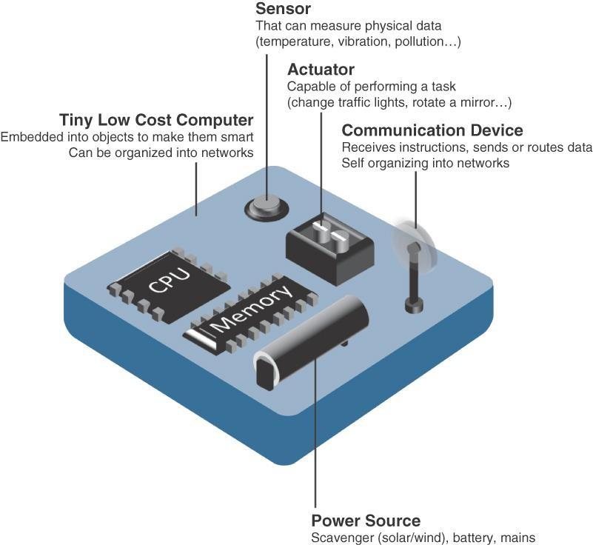
A smart object, is a device that has, at a minimum, the following four defining characteristics

Slide 39
Processing unit:
Some type of processing unit for
–Acquiring data,
– Processing and analyzing sensing information received by the sensor(s),
– Coordinating control signals to any actuators, and
– Controlling a variety of functions on the smart object, including the communication and power systems
The most common is a microcontroller because of its small form factor, flexibility, programming simplicity, ubiquity, low power consumption, and low cost
Sensor(s) and/or actuator(s):
A smart object is capable of interacting with the physical world through sensors and actuators

Slide 40
3. Communication device:
The communication unit is responsible for connecting a smart object with other smart objects and the outside world (via the network).
Communication devices for smart objects can be either
wired or wireless
4. Power source:
Smart objects have components that need to be powered.
The most significant power consumption usually comes from the communication unit of a smart object

Slide 41
Trends in Smart Objects
Size is decreasing
Power consumption is decreasing
Processing power is increasing
Communication capabilities are improving
Communication is being increasingly standardized

Slide 42
standardization of communication protocols is a complicated task.
While there isn’t a single protocol solution, there is beginning to be some clear market convergence around several key communication protocols.

Slide 43
Connecting Smart Objects
IoT devices and sensors must be connected to the network for their data to be utilized.
In addition to the wide range of sensors, actuators, and smart objects that make up IoT, there are also a number of different protocols used to connect them.

Slide 44
COMMUNICATIONS CRITERIA
The characteristics and attributes you should consider when selecting and dealing with connecting smart objects
Range
Frequency Bands
Power Consumption
Topology
Constrained Devices
Constrained-Node Networks

Slide 45
Range
How far does the signal need to be propagated?
That is, what will be the area of coverage for a selected wireless technology?
Should indoor versus outdoor deployments be differentiated?

Slide 46
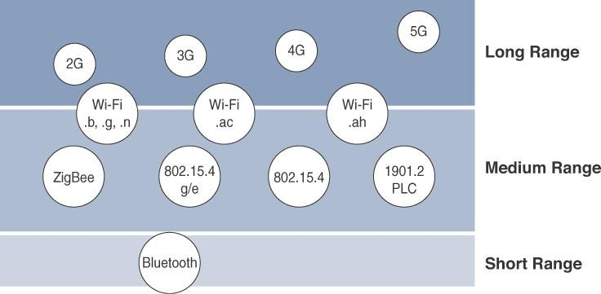
> 1 km
< 1 km
10’s of meters
Various wireless technologies that are popular in IoT domain

Slide 47
Short range:
The classical wired example is a serial cable.
Wireless short-range technologies are often considered as an alternative to a serial cable, supporting tens of meters of maximum distance between two devices.
Examples of short-range wireless technologies are IEEE
802.15.1 Bluetooth and IEEE 802.15.7 Visible Light Communications (VLC)

Slide 48
Medium range:
This range is the main category of IoT access technologies.
In the range of tens to hundreds of meters, many specifications and implementations are available.
The maximum distance is generally less than 1 mile between two devices
Examples of medium-range wireless technologies include IEEE 802.11 Wi-Fi, IEEE 802.15.4, and 802.15.4g WPAN.
Wired technologies such as IEEE 802.3 Ethernet and IEEE 1901.2 Narrowband Power Line Communications (PLC)

Slide 49
Long range:
Distances greater than 1 mile between two devices require long-range technologies.
Wireless examples are cellular (2G, 3G, 4G) and some applications of outdoor IEEE 802.11 Wi-Fi and Low-Power Wide-Area (LPWA) technologies.
LPWA communications have the ability to communicate over a large area without consuming much power. These technologies are therefore ideal for battery-powered IoT sensors

Slide 50
2. Frequency Bands
Radio spectrum is regulated by countries and/or organizations, such as the International Telecommunication Union (ITU) and the Federal Communications Commission (FCC).
These groups define the regulations and transmission requirements for various frequency bands
For example, portions of the spectrum are allocated to types of telecommunications such as radio, television, military, and so on.

Slide 51
Focusing on IoT access technologies, the frequency bands leveraged by wireless communications are split between licensed and unlicensed bands.
Licensed spectrum is generally applicable to IoT long- range access technologies
In order to utilize licensed spectrum, users must subscribe to services when connecting their IoT devices
In exchange for the subscription fee, the network operator can guarantee the exclusivity of the frequency usage over the target area and can therefore sell a better guarantee of service.

Slide 52
The ITU has also defined unlicensed spectrum for the industrial, scientific, and medical (ISM) portions of the radio bands.
These frequencies are used in many communications
technologies for short-range devices (SRDs).
Unlicensed means that no guarantees or protections are offered in the ISM bands for device communications.
ISM bands for IoT access:
Devices operating in 2.4 GHz band range include Wi-Fi, Bluetooth, IEEE 802.15.4 that includes WPAN,Zigbee etc.. ,
Baby monitors ,microwave ovens, cordless telephones etc..

Slide 53
Unlicensed spectrum is usually simpler to deploy than licensed because it does not require a service provider.
However, it can suffer from more interference because other devices may be competing for the same frequency in a specific area.
The frequency of transmission directly impacts how a signal propagates and its practical maximum range.

Slide 54
3. Power Consumption
Powered nodes and battery-powered nodes
A powered node has a direct connection to a power source, and communications are usually not limited by power consumption criteria.
However, ease of deployment of powered nodes is limited by the availability of a power source, which makes mobility more complex

Slide 55
Battery-powered nodes bring much more flexibility to IoT devices.
These nodes are often classified by the required lifetimes of their batteries.
For battery powered nodes, wireless access technologies must address the needs of low power consumption and connectivity.
Battery-powered nodes are often placed in a “sleep mode” to preserve battery life when not transmitting.

Slide 56
4. Topology
Among the access technologies available for connecting IoT devices, three main topology schemes are dominant: star, mesh, and peer-to-peer
For long-range and short-range technologies, a star topology is prevalent.
Star topologies utilize a single central base station or controller to allow communications with endpoints
For medium-range technologies, a star, peer-to-peer, or mesh topology is common
Peer-to-peer topologies allow any device to communicate with any other device as long as they are in range of each other

Slide 57
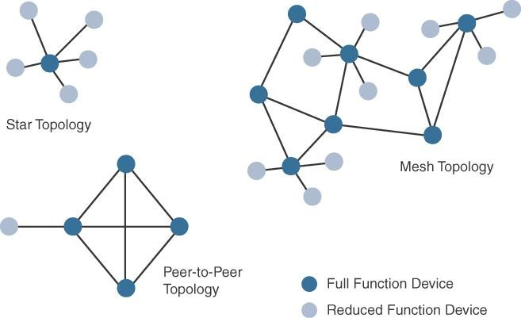
Ex: Indoor Wi-Fi deployments and Outdoor Wi-Fi deployments

Slide 58
Constrained nodes have limited resources that impact their networking feature set and capabilities.

Slide 59
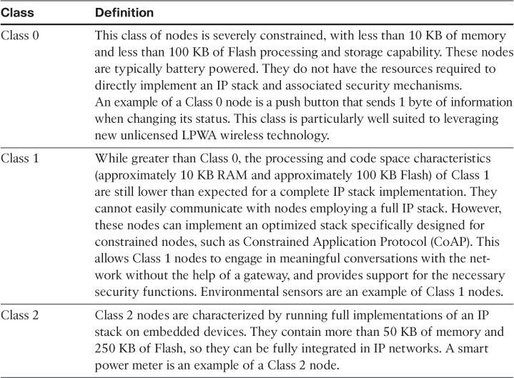
5. Constrained Devices:Constrained nodes have limited resources that impact their networking feature set and capabilities.

Slide 60
Some IoT access technologies are more suited to specifically connect constrained nodes.
e.g IEEE 802.15.4 and 802.15.4g RF, IEEE 1901.2a PLC,LPWA, and IEEE 802.11ah access technologies
6. Constrained-Node Networks
Constrained-node networks are often referred to as low-power and lossy networks (LLNs).
Low power – refers to the fact that nodes must cope with the
requirements from powered and battery-powered constrained nodes.
Lossy network -- indicates that network performance may suffer from interference and variability due to harsh radio environments.
Protocols that can be used for constrained-node networks must be evaluated in the context of characteristics like data rate and throughput, latency and determinism, and overhead and payload. ***

Slide 61
Some IoT access technologies are more suited to specifically connect constrained nodes.
e.g IEEE 802.15.4 and 802.15.4g RF, IEEE 1901.2a PLC,LPWA, and IEEE 802.11ah access technologies
6. Constrained-Node Networks
Constrained-node networks are often referred to as low-power and lossy networks (LLNs).
Low power – refers to the fact that nodes must cope with the
requirements from powered and battery-powered constrained nodes.
Lossy network -- indicates that network performance may suffer from interference and variability due to harsh radio environments.
Protocols that can be used for constrained-node networks must be evaluated in the context of characteristics like data rate and throughput, latency etc…

